Slide 1
Hand-Operated
Combi Tools
HCT 5111 / 5114 / 5117 ST

Slide 2

Notes:
Introduction video HCT 5111/5117 ST

Slide 3
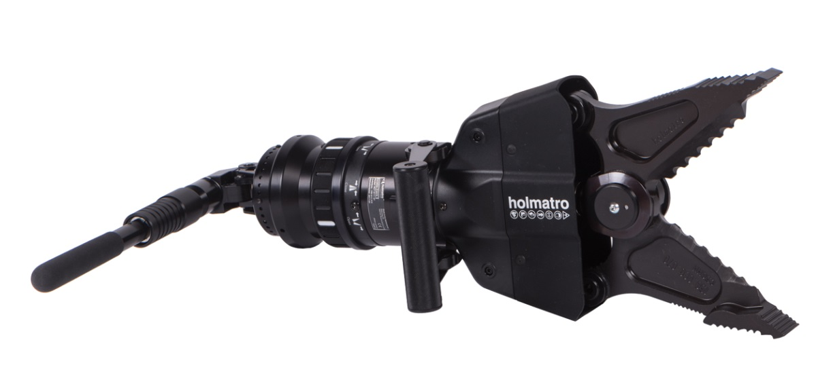
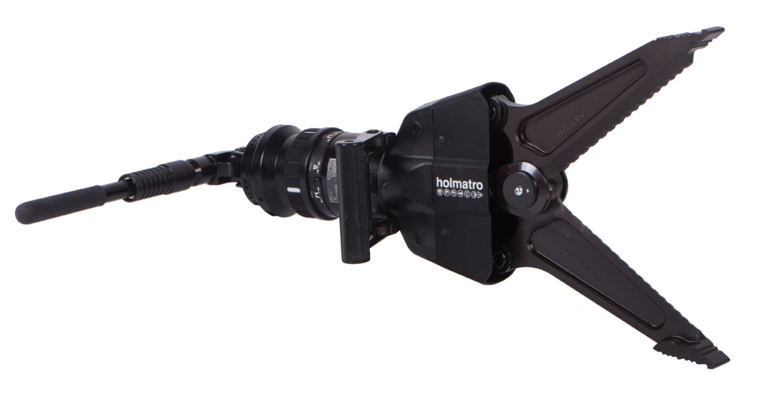
Features
Hand-Operated Combi Tools HCT 5111 / 5114 / 5117 ST
Ultra-lightweight, compact solution for tactical cutting, squeezing and spreading
  Only 8.7 kg – 19.2 lb (model HCT 5111 ST)
  Easy to add to your existing kit
  Easy to carry, transport and store
  Suitable for airborne operations
  Carrying handle and pump handle 90° foldable for extra compactness
HCT 5111 ST
HCT 5114 ST
HCT 5117 ST

Slide 4
Optimal performance to weight ratio
Hand-Operated Combi Tools HCT 5111 / 5114 / 5117 ST
Extremely high spreading force compared to size and weight - model HCT 5111 ST
Extremely large spreading distance compared to size and weight - model HCT 5117 ST
Higher spreading force than 5117 version and larger spreading distance than 5111 version – model HCT 5114 ST
High cutting force compared to size and weight
(all models)

Slide 5
Multifunctional
Hand-Operated Combi Tools HCT 5111 / 5114 / 5117 ST
Suitable for both cutting and spreading
Suitable for dive operations / under water use
Suitable for a variety of applications, ranging from forcible entry to extrication of persons trapped
Your choice: HCT 5111 ST for highest spreading force,
HCT 5117 ST for highest spreading distance or HCT 5114 as the ideal inbetween model

Slide 6
Integrated 2-stage hand pump
Hand-Operated Combi Tools HCT 5111 / 5114 / 5117 ST
For low noise operations
Self-contained for optimal freedom of movement
Rapid deployment
Easy operation: simply fold out the pump handle and start pumping

Slide 7
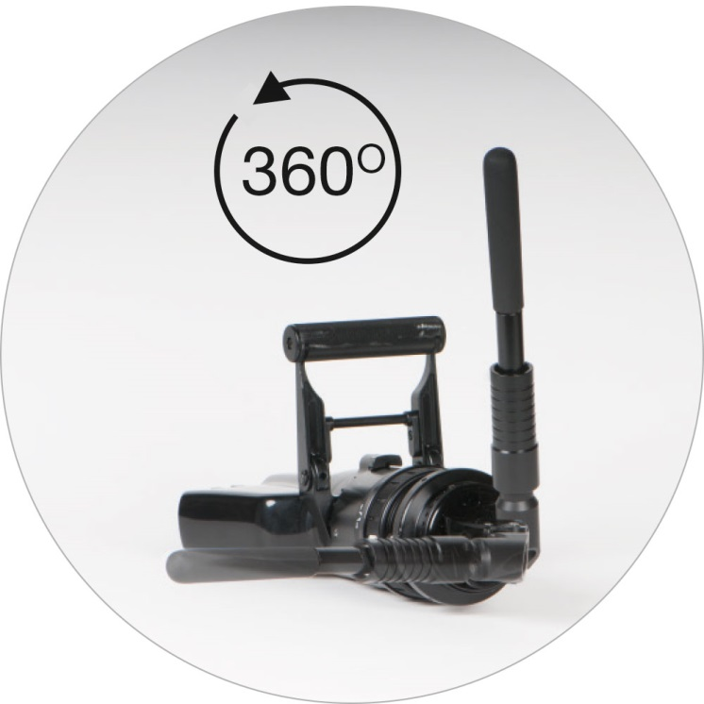
360° rotatable carbon fiber pump handle
Hand-Operated Combi Tools HCT 5111 / 5114 / 5117 ST
Can be locked in 22 positions
For use of the tool in almost any position

Slide 8
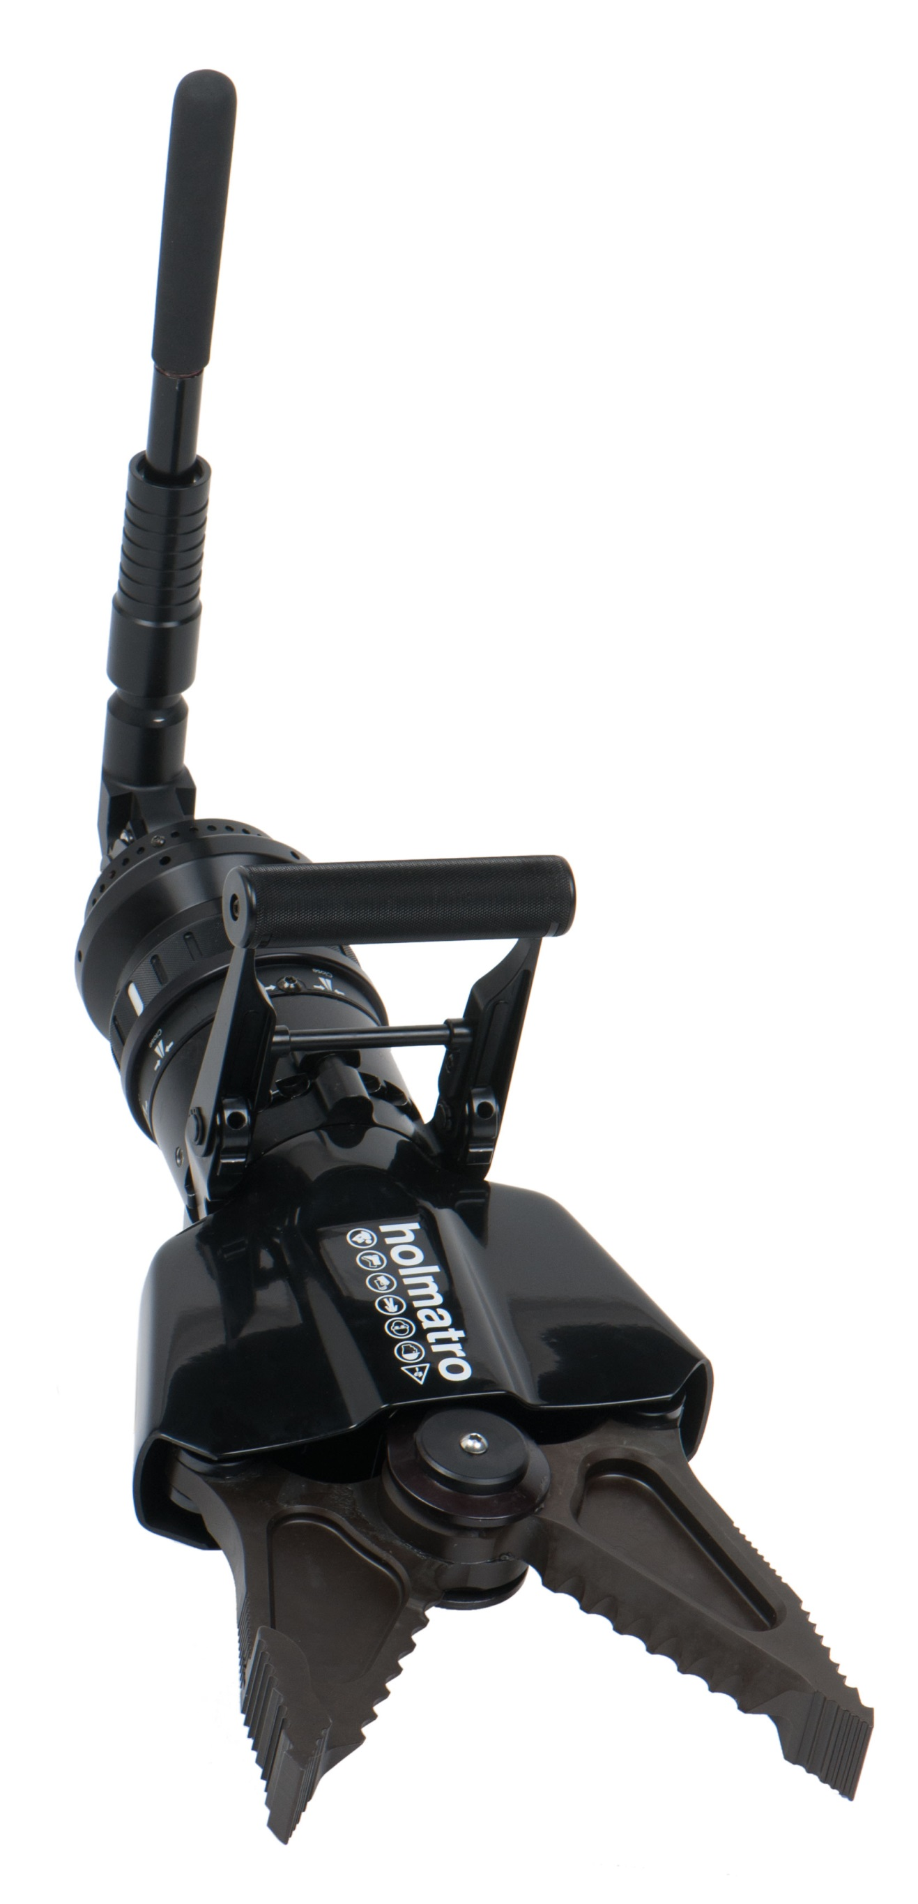

360° rotatable aluminum carrying handle
Hand-Operated Combi Tools HCT 5111 / 5114 / 5117 ST
Continuous swivel with 11 locking positions
For use of the tool in almost any position

Slide 9
Non-slip selection ring
Hand-Operated Combi Tools HCT 5111 / 5114 / 5117 ST
Easy, intuitive selection of spreading, squeezing or cutting
Offers good grip

Slide 10
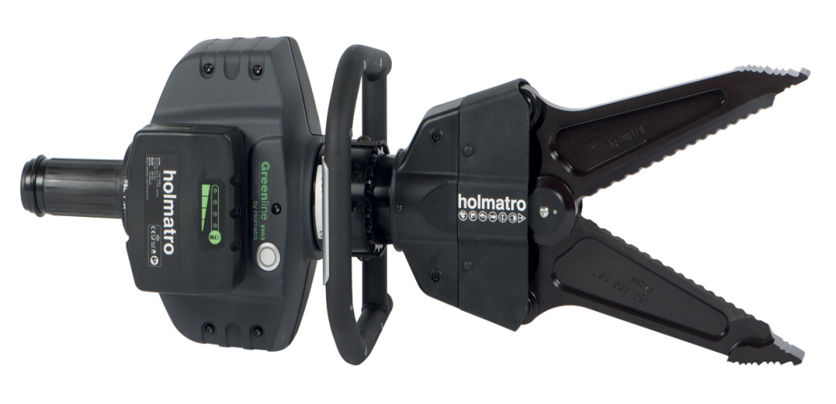
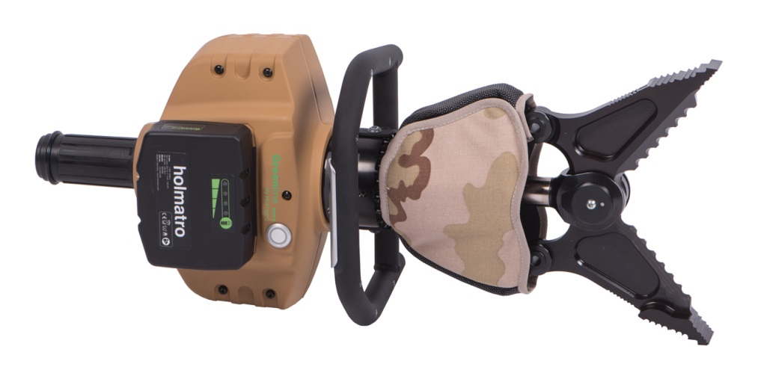
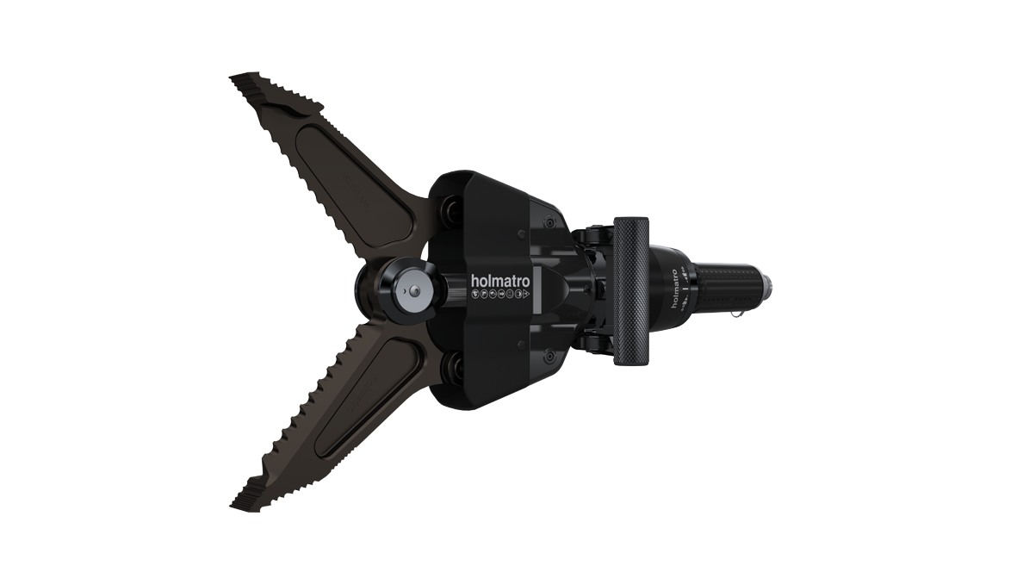
Also available
Hand-Operated Combi Tools HCT 5111 / 5114 / 5117 ST
Battery-operated models GCT 5111 / 5114 / 5117 ST EVO 3
Battery-operated models Army-version GCT 5111 / 5114 / 5117 STA EVO 3
Pump-operated models CT 5111 / 5114 / 5117 ST
Battery-operated GCT 5117 ST EVO 3
Battery-operated model Army-version GCT 5111 STA EVO 3
Pump-operated model CT 5114 ST

Slide 11
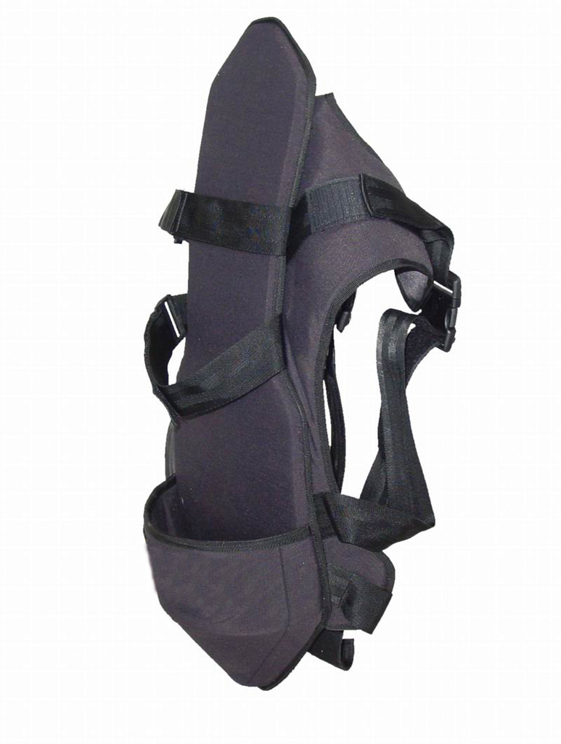
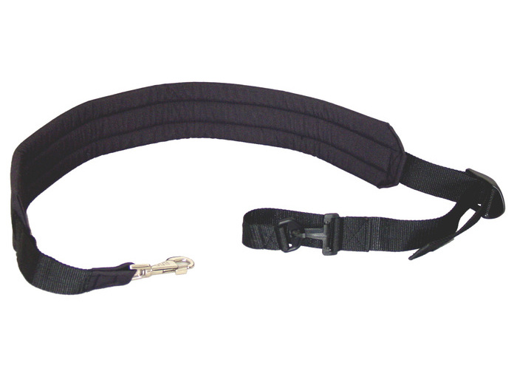
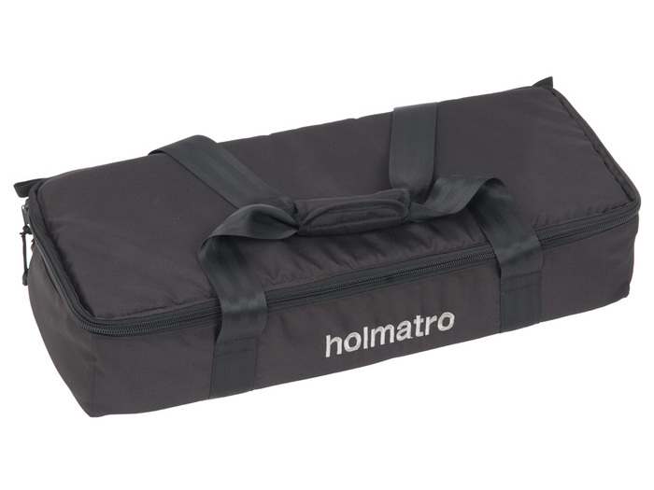
Accessories
Hand-Operated Combi Tools HCT 5111 / 5114 / 5117 ST
Carrying strap
Carrying harness
Carrying / storage bag
Model 5117: also pulling adapters and pulling chains
For EVO 3 battery-powered versions: also batteries, chargers and a mains power connector

Slide 12

Hand-Operated Combi Tools HCT 5111 / 5114 / 5117 ST
Breaking Barriers

